Slide 1




Software University
Curriculum, Courses, Exams, Jobs
SoftUni Team
Technical Trainers
Software University
http://softuni.bg

Slide 2

Welcome to SoftUni
Software University (SoftUni)
High-quality education, profession and jobs for software engineers
20+ practical courses, 20+ exams, 15+ projects → ~ 2 years
Bachelor diploma: 2 years @ SoftUni + 1 year at partner university
Study onsite and online (with onsite exams)
Jobs in Bulgaria and abroad
Free start for everyone
New Programming Basics course each month

Slide 3
SoftUni: Levels, Modules, Schedule
Programming Basics
2 months
6 credits
Programming Fundamentals
36 credits
6 months
Advanced C#
Object-Oriented Programming
High-Quality Code
Java Basics
Teamwork and Personal Skills
Web Front-End
Back-End
36 credits
36 credits
HTML + CSS + WordPress
JavaScript Basics
Advanced JavaScript
Databases
Database Applications
Web Services and Cloud
6 months
JavaScript Applications
JavaScript Frameworks
PHP Web Development
ASP.NET MVC Web Development

Slide 4
Diplomas and Certificates
Certificates
C# Developer (graduated the Programing Fundamentals module)
Front-End Developer (graduated the Front-End module)
Back-End Developer (graduated the Back-End module)
Web Developer (graduated the Front-End + Back-End modules)
Diploma from SoftUni
130 credits (from passed courses with exams)
Basics + Fundamentals + Front-End + Back-End = 114 credits

Slide 5
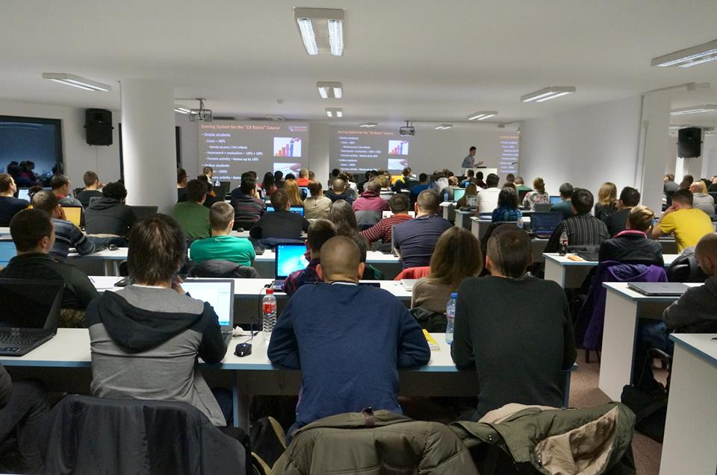
Specialized Courses
Students take credits from specialized (elective) courses
QA Fundamentals
IT Basics
Digital Marketing and SEO
Data Structures
Algorithms
Many others …
The elective courses are open for everyone

Slide 6
Jobs
SoftUni helps the students to start a job in the IT industry
Contracts with 60+ companies for hiring students
Best students study free with scholarship
Top 10% of all onsite students
Students with high results choose between many employers
Students with bad results are not guaranteed to start a job
Internships in Germany and USA

Slide 7









Software University
https://softuni.bg

Slide 8




SoftUni Diamond Partners

Slide 9

QA Fundamentals Partner

Slide 10
License
This course (slides, examples, demos, videos, homework, etc.) is licensed under the "Creative Commons Attribution-NonCommercial-ShareAlike 4.0 International" license
Attribution: this work may contain portions from
"Fundamentals of Computer Programming with C#" book by Svetlin Nakov & Co. under CC-BY-SA license
"C# Part I" course by Telerik Academy under CC-BY-NC-SA license

Slide 11





Free Trainings @ Software University
Software University Foundation – softuni.org
Software University – High-Quality Education, Profession and Job for Software Developers
softuni.bg
Software University @ Facebook
facebook.com/SoftwareUniversity
Software University @ YouTube
youtube.com/SoftwareUniversity
Software University Forums – forum.softuni.bg

